Slide 1

Team Name : Meaniki AI Lab
Team Leader Name : Eric Mwaniki
Which domain does your idea address? (Agriculture / Healthcare / Skilling / Education): AI/Technology

Slide 2

What is the problem you are solving? (50 words max)
The problem being solved is automating the classification of grant proposals into "funded" or "not funded" categories using AI. The solution also incorporates anomaly detection to identify potentially fraudulent proposals, improving the efficiency and accuracy of grant evaluation processes for organizations and funding agencies

Slide 3
Describe your solution. How different is it from any of the other existing ideas? How will it be able to solve the problem? USP of the proposed solution? What is the intended impact of your solution (max 350 words).
The Grant Proposal Classification Pipeline is an AI-driven solution that automates the classification of grant proposals into "funded" or "not funded" categories. Using machine learning models like Logistic Regression, Random Forest, XGBoost, and SVM, along with text analysis (TfidfVectorizer) and numerical feature processing, the solution provides accurate predictions. An anomaly detection model (IsolationForest) identifies potentially fraudulent proposals, enhancing security in the evaluation process.
What sets this solution apart is its combination of multiple machine learning techniques, fraud detection, and text processing, making it a robust, scalable, and transparent solution for grant evaluation. The intended impact is to streamline the grant review process, saving time and reducing human bias, while ensuring more accurate and fair funding decisions.

Slide 4
Who is the primary user of your solution, and explain how your solution will leverage open-source AI to address the aspects mentioned in the Key Design Guidelines (max 200 words).
The solution targets grant funding organizations (e.g., government and research institutions) to automate the classification of grant proposals and detect fraud, improving efficiency and accuracy. It uses open-source AI tools like scikit-learn for machine learning, nltk for text processing, and joblib for model saving, ensuring scalability and cost-effectiveness.
Key design features:
Scalability: Handles large datasets with models like XGBoost and SVM.
Fairness: Reduces human bias through automation.
Efficiency: Speeds up the review process by automating proposal classification.
Security: Detects fraudulent proposals using anomaly detection.
This solution offers a comprehensive, efficient, and secure grant evaluation process using open-source AI tools.

Slide 5
How is this solution scalable? (100 words max)
This solution is scalable due to its use of machine learning models like XGBoost and SVM, which can efficiently handle large datasets and diverse proposals. The use of TfidfVectorizer for text data and StandardScaler for numerical features ensures that the solution can process high volumes of data while maintaining accuracy. Additionally, the modular nature of the pipeline allows easy integration of more data sources, models, or features as the volume of proposals increases, ensuring the system can grow with the needs of the funding organization. This makes it suitable for small to large-scale applications.

Slide 6
List of features offered by the solution
Automated Proposal Classification: Classifies grant proposals as "funded" or "not funded" using machine learning models.
Text Processing: Uses TfidfVectorizer for converting text data (titles and abstracts) into numerical features.
Numerical Feature Processing: Scales numerical features like budget, research impact using StandardScaler.
Fraud Detection: Identifies potentially fraudulent proposals using anomaly detection (IsolationForest).
Multiple Model Support: Utilizes several models, including Logistic Regression, Random Forest, XGBoost, and SVM.
Hyperparameter Tuning: Optimizes model performance with GridSearchCV.
Model Evaluation: Evaluates model performance using F1-Score, classification report, and ROC-AUC.
Model Saving: Saves trained models using joblib and pickle for later use.
Scalability: Efficiently handles large datasets and diverse proposals.
Customizability: The pipeline can be easily adapted to different data sources and organizational needs.

Slide 7
What open-source AI tools and technologies will you use to design the solution? (Please list all.)
scikit-learn: For machine learning models (Logistic Regression, Random Forest, XGBoost, SVM), model evaluation, and hyperparameter tuning.
nltk: For text processing, including tokenization, lemmatization, and stopword removal.
TfidfVectorizer: For transforming text data (titles and abstracts) into numerical features using TF-IDF.
StandardScaler: For scaling numerical features like budget and research impact.
IsolationForest: For anomaly detection to flag potentially fraudulent proposals.
GridSearchCV: For hyperparameter optimization and model tuning.
joblib: For saving and loading machine learning models and preprocessing tools.
pickle: For serializing models and preprocessing steps for later use.

Slide 8
Why are these open-source technologies the most appropriate for your solution? (150 words max)
These open-source technologies are the most appropriate for the solution because they offer scalability, flexibility, and proven effectiveness.
scikit-learn provides a wide range of efficient machine learning models like Logistic Regression, Random Forest, XGBoost, and SVM, which are ideal for classification tasks and handling large datasets.
nltk and TfidfVectorizer are robust for text processing, converting textual data into actionable features, essential for grant proposal classification.
StandardScaler ensures numerical feature scaling for better model performance.
IsolationForest excels at detecting anomalies, helping identify potentially fraudulent proposals.
GridSearchCV allows for easy optimization of hyperparameters to fine-tune model performance.
joblib and pickle facilitate seamless model saving and loading, enabling future scalability.
These tools are well-supported, widely used, and cost-effective, making them highly suitable for creating a flexible, scalable, and efficient grant proposal evaluation pipeline.

Slide 9
Describe the Solutions Architecture (500 words)
The Grant Proposal Classification Pipeline AI leverages a modular architecture, utilizing several components that work together to automate the process of classifying grant proposals, detecting anomalies, and ensuring secure evaluations. The architecture follows a data-driven approach, integrating data processing, machine learning, and model evaluation in a seamless pipeline. Below is an outline of the key components of the architecture:
1. Data Ingestion and Preprocessing:
Data Source: The primary data source is a CSV file (grant_proposals_synthetic.csv), containing grant proposals with fields like titles, abstracts, budgets, and research impact.
Data Cleaning: The first step involves cleaning and preparing the data. Missing values are handled, and categorical variables (e.g., institution names) are encoded.
Text Processing: The title and abstract columns undergo text cleaning, including:
Converting text to lowercase.
Removing non-alphabetic characters.
Tokenizing text and lemmatizing to reduce words to their root form.
Feature Engineering: New features are created, such as:
Title_Length and Abstract_Length (to capture the length of the text fields).
Budget_to_Experience (the ratio of budget to researcher experience).
Numerical Scaling: Numerical columns like budget and research impact are scaled using StandardScaler to normalize values and improve model performance.
2. Text Feature Extraction:
The TfidfVectorizer is used to convert text data (title and abstract) into numerical features. This approach calculates the Term Frequency-Inverse Document Frequency (TF-IDF) for each word, helping to capture the importance of each word relative to the entire dataset.
N-grams (unigrams, bigrams, etc.) are used for richer context capture, providing the model with more granular features for better classification performance.
3. Model Training and Evaluation:
Machine Learning Models: Several models are used for the classification task:
Logistic Regression: A simple, interpretable model for baseline performance.
Random Forest: An ensemble method that improves predictive power by averaging multiple decision trees.
XGBoost: A high-performing gradient boosting algorithm that excels in classification tasks.
Support Vector Machine (SVM): A model used for high-dimensional data classification, particularly effective when the dataset contains complex, non-linear patterns.
Hyperparameter Tuning: The model selection and tuning process is automated using GridSearchCV, which performs an exhaustive search over specified hyperparameters and selects the best-performing configuration.
Evaluation Metrics: The models are evaluated based on:
F1-Score: Balances precision and recall, especially important when dealing with imbalanced datasets.
ROC-AUC: Provides insight into the model's ability to distinguish between classes.
Classification Report: Details precision, recall, and F1-score for each class.
4. Fraud Detection:
Anomaly Detection (Isolation Forest): A specialized model is used to detect outliers in the data, which could indicate potential fraud. This is especially important for detecting fraudulent or anomalous proposals that may not follow typical funding patterns.
The anomaly detection model operates on the funded proposals, using the characteristics of the proposals to identify unusual patterns.
5. Model Deployment and Serialization:
Model Saving: All trained models (classification models, vectorizers, and scaler) are saved using joblib and pickle. This ensures that models can be easily loaded for future inference without retraining.
Model Loading: When new proposal data is received, the saved models are loaded, and the data undergoes the same preprocessing pipeline to ensure consistency. The data is then passed through the model for prediction.
6. Pipeline Integration:
The entire process, from data ingestion to model prediction, is encapsulated in a pipeline. The pipeline is designed to handle new data and can be run periodically or in real-time, depending on the organizational requirements.
Scalability: The architecture allows for easy scaling, whether by increasing the volume of proposals or expanding the feature set (e.g., adding more text data or incorporating additional numerical features).
Flexibility: The modular structure of the solution means that new models or features can be integrated easily, and it can be adapted to different types of grant proposals or funding organizations.
7. Security and Monitoring:
Security: The fraud detection mechanism using IsolationForest ensures that potentially fraudulent proposals are flagged, adding a layer of security to the evaluation process.
Monitoring: Continuous monitoring of the system’s performance is essential for identifying drift in model predictions or anomalies in the data, ensuring the system remains accurate and secure over time.
This solution architecture provides a robust, scalable, and secure pipeline for classifying and evaluating grant proposals, detecting fraud, and ensuring efficiency in the funding decision-making process.

Slide 10
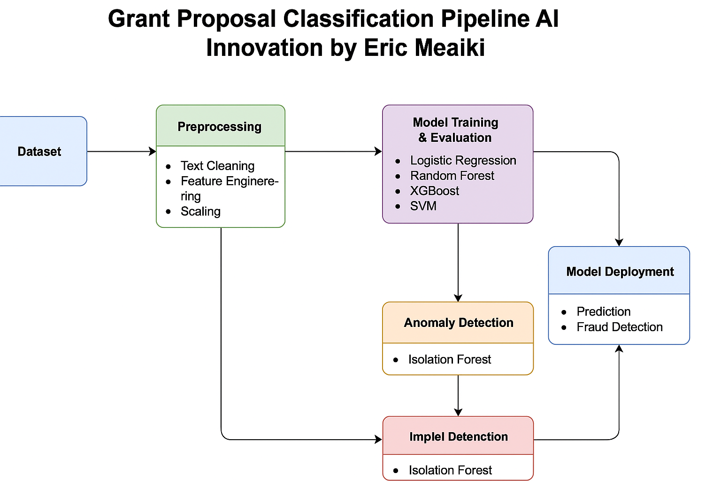
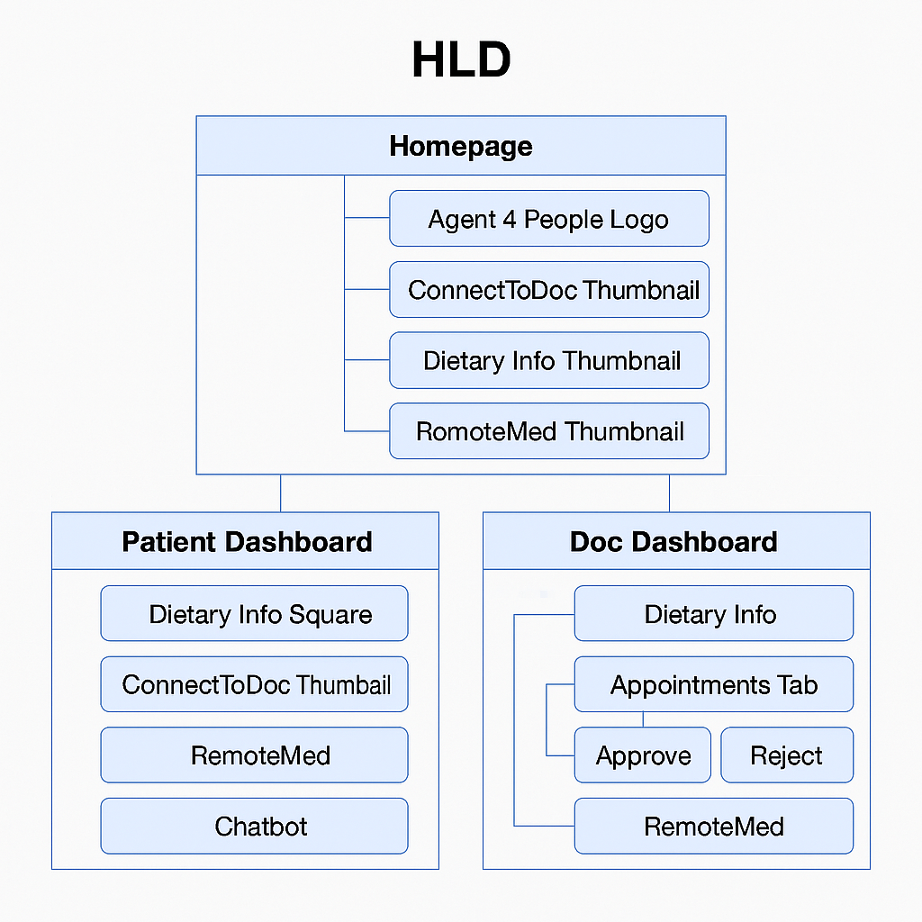
Provide a high-level architecture diagram or a use-case diagram of your proposed solution

Slide 11
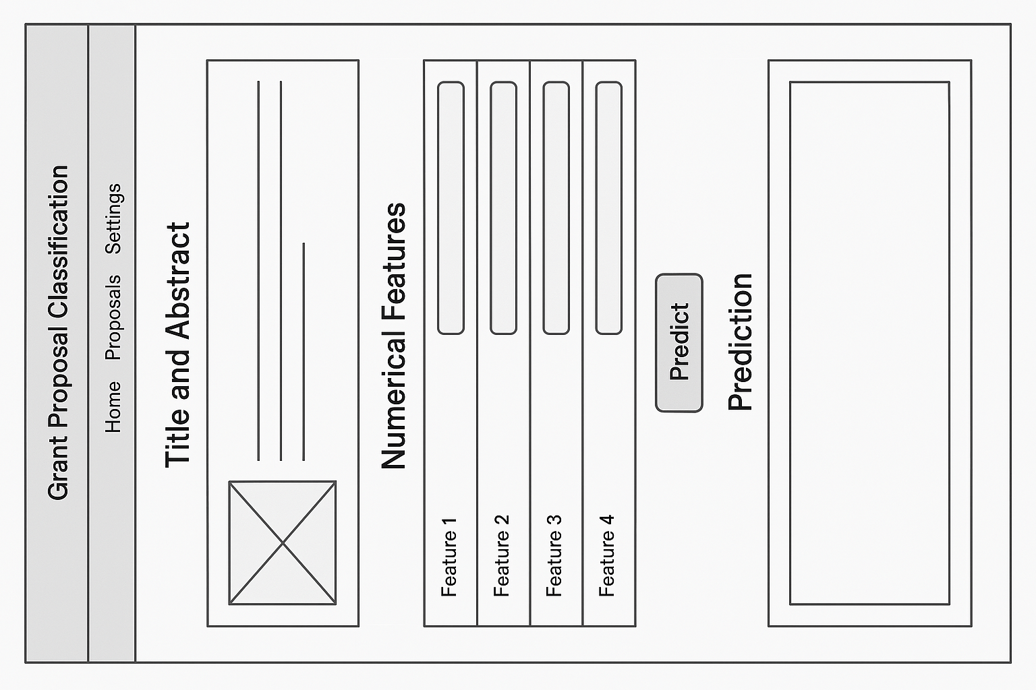
Please share the wireframes/Mock diagrams of the proposed solution (optional)

Slide 12
What datasets will your solution use? Are they publicly available, synthetic, or user-generated?
The solution uses the following datasets:
Grant Proposals Dataset:
Description: This dataset contains synthetic grant proposal data, including fields like title, abstract, budget, research impact, and funding status (e.g., funded or not funded).
Type: Synthetic dataset, specifically designed to simulate real-world grant proposal data for classification tasks.
Availability: The dataset is not publicly available but is generated specifically for this solution.
Additional Datasets (optional):
Description: Depending on the specific project or use case, the solution can be adapted to work with additional datasets like real-world grant proposals, institutional data, or proposal outcome datasets.
Type: These may either be user-generated or publicly available datasets, depending on the organization's requirements.
The synthetic dataset ensures privacy and serves as a good starting point for training and testing models, making it an appropriate choice for developing the solution. The use of synthetic data also allows for easy adaptation and extension of the solution in real-world applications.

Slide 13
Does your solution require cloud-based computation, or can it work with on-device processing? If cloud-based, how do you plan to address connectivity challenges and cost constraints?
The solution can be implemented both with cloud-based computation or with on-device processing, depending on the scale and use case. Here's a breakdown of both approaches:
Cloud-based Computation:
Why Cloud-based: For large-scale data processing, model training, and real-time predictions, cloud infrastructure is preferred. It enables easier scaling, storage of large datasets, and the ability to train complex models (like XGBoost or Random Forest) without being limited by local hardware constraints.
Handling Connectivity Challenges:
Data Storage: The dataset can be stored on cloud storage services (e.g., AWS S3, Google Cloud Storage), ensuring it’s accessible from anywhere. To mitigate intermittent connectivity issues, data can be downloaded in chunks and processed locally if needed.
Offline Mode: The models can be designed to operate in an offline mode with periodic updates from the cloud. This allows the solution to continue functioning even when connectivity is temporarily disrupted.
Edge Computing: For certain parts of the solution (like real-time predictions), edge devices (e.g., IoT devices) can process data locally and sync with the cloud at scheduled intervals to minimize latency and bandwidth issues.
Cost Constraints:
Cost Management: Cloud services like AWS, GCP, or Azure offer flexible pricing models (e.g., pay-as-you-go), so costs can be optimized based on usage. For large-scale operations, data processing and model training can be done in bursts, reducing the need for continuous computation.
Optimization: Using pre-trained models, optimizing data storage, and compressing datasets can help reduce cloud usage costs. Cloud services also allow auto-scaling, where resources can scale up or down based on demand, avoiding over-provisioning and unnecessary costs.
On-device Processing:
Why On-device: For smaller datasets or for real-time edge applications where low latency is crucial, the solution can be adapted to run on devices with sufficient processing power (e.g., laptops, smartphones, or edge computing devices).
Challenges:
Limited Resources: On-device processing may face constraints in terms of memory, processing power, and storage for handling large datasets or complex models.
Model Compression: Techniques like model pruning, quantization, and knowledge distillation can be used to reduce the size of the models and make them more efficient for on-device deployment.
In summary, while the solution can operate in both cloud-based and on-device environments, cloud-based computation is preferred for handling large-scale tasks, dataset management, and complex model training, with strategies in place to handle connectivity challenges and cost constraints. On-device processing can be used for specific applications requiring real-time predictions and reduced dependency on continuous internet access.

Slide 14
